Slide 1
Update September 30
Ran simulation
NEMO-MEDUSA ORCA0083-N006 1/12º
Temporal resolution of 5 days.
Backtrack for 5 years.
dt = 1h
Assuming particles neutrally bouyant.
Initial condition 32.171ºS, 6.287ºW (as reported in Meirer 2021)
10000 particles going from -1m to -5000m depth.
No diffusion kernel.

Slide 2
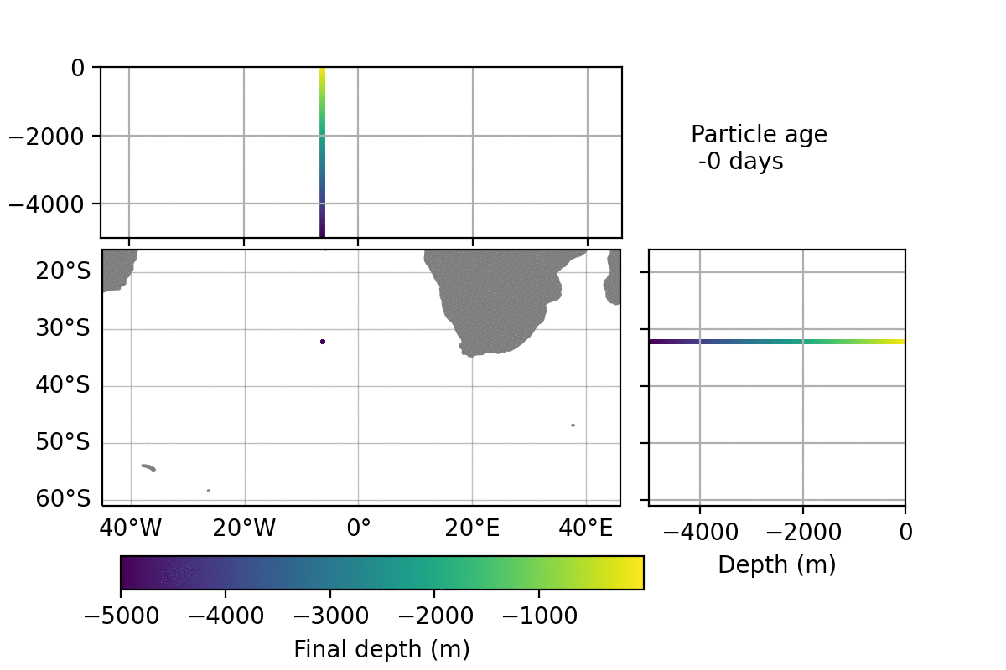

Slide 3
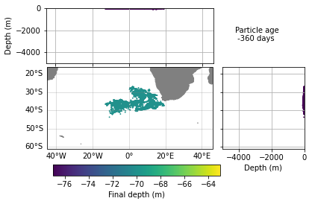
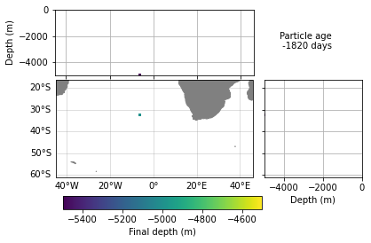
Test and failed simulations
final depth -70m
Final depth: -5000m

Slide 4
Article:
Included the table on main text.
The likelihood map remains in SM
The text in SM describes the likelihood map.
No limit of PUs for JGR: Oceans.
I plan to submit it tomorrow afternoon.

